Slide 1
CLOZAPINE
No longer lost in a labyrinth

Slide 2
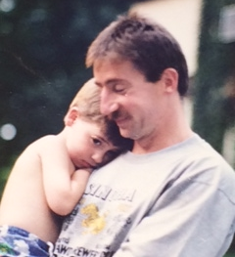
My son Daniel

Slide 3
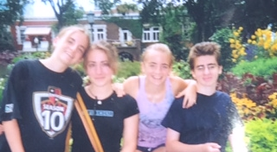
Daniel, 15 with family and voices

Slide 4

Daniel with his twin sisters

Slide 5
CLOZAPINE
Evidence Based Medicine
Daniel out of the Minotaur’s maze

Slide 6
Clozapine:
An Historical Perspective
Clozapine has always challenged the mental health system
1950’s Synthesized in 1958. Not long after (thorazine) FDA approved in 1953. First Pharma “Blockbuster”
1960 Patented in 1960; Patients and family loved it. Psychiatry stuck on dopamine and not widely used.
1989 FDA approved in 1989 after held to unprecedented standard: demonstrating marked improvement in treatment refractory population when compared to standard of care. Sandoz tried to bundle and cost prohibitive so medication restricted and rationed

Slide 7
Clozapine Risks
Agranulocytosis
Seizures
Intractable weight gain with diabetes
Unremitting sedation
Drooling
Intractable constipation
Myocarditis and heart failure
Rebound psychosis if withdrawn
Venous Thromboembolism (VTE)
Pulmonary Infection

Slide 8
My Patients
Treating over 200 patients with PSMI as of 2/1/2019
Co-management of 170 individuals treated with Clozapine since 2008. In practice 105 and 67 at Bronx State (employed as clozapine consultant )
3. As of 2/1/2019: Responsible for 72 in the practice. 70 in practice on Clozapine REMS (Risk Evaluation and Mitigation Strategies FDA program no blood no drug). 13 seen in practice and remain on clozapine but presently followed elsewhere. Therefore:
4. Written clozapine for 105 individuals and documented 85/105 remain on clozapine.
Of other 20:
A. 6 Lost to follow up
B. 8 patients withdrew in the first 3 months
C. 4 patients withdrawn by physician (all of these patients had BPD)
D. 2 patients expired (both of these patients were elderly with PD)
E. In the 93 living patients with a known outcome 85/93 remain
on clozapine (91.4%). As of this review only 1 patient with intolerable outcome.
5. Meaningful Recovery in patients with over 3 months continuously on clozapine (defined as being in school, work, or retired): 48/72: 30 patients work, 14 patients are in school, and 4 retired. In addition of the other 24 patients 10 are in PROS programs Personalized Recovery Oriented Services) or involved in a Club House. Recovery over 80%.

Slide 9
My Patients
Hospitalization rate is minimal: With 1800 months(150 patient yeas) of clozapine there have been patients hospitalized for a total of 5 months (0.67% of time on therapy)
7. Weight assessment in 74 patients with follow up over 3 months (significant weight change defined as greater than 10 pounds):
A. 34 with weight loss
B. 25 no change, (59/74 80%)
C. 15 (20%) with weight gain (31 patients had less than 3 months f/u and were excluded from this analysis, of this 2 with weight gain and the remainder without change)
8. Other Adverse Outcome:
A. 1 cardiomyopathy
B. 1 seizure
C. 1 admit for obstipation
D. 3 pneumonias none required in patient treatment.

Slide 10
My Patients
1. In my practice:
NO SUICIDE - NO INCARCERATION - 1 SEIZURE
NO AGRANULOCYTOCIS - 1 CARDIOMYOPATHY
1 elderly patient resolved cardiomyopathy with clozapine withdrawal
2. Patient identifying characteristics:
A. Diagnosis of the 105: 1. 65 Schizophrenia spectrum disorder, 2. 21 Bipolar with psychosis, 3. 8 Borderline/ psychosis, 4. 2 PD, 5.1 psychotic depression, 6. 5 Psych NOS, 7. and 3 drug related psychosis
B. Of the 72 patients active in the practice: 46 with history of Co-occurring Substance Abuse/ 30 now in recovery. In this same group of 72: 37 originally smoked cigarettes and 19 have quit.
C. 42/105 patients with Anosognosia: 1. 27 remain in practice on clozapine,
9 patients remain on clozapine elsewhere, 6 patients stopped (3 of these lost to f/u)
3. 2/72 on an additional anti-psychotic, 40 patients on fluvoxamine, and 54 patients on lamotrigine

Slide 11
Our Goals – Restore
WE CAN RESTORE OPTIMAL HEALTH – BODY AND MIND
Patient has a sense of purpose and self, enabling them to form relationships and be a productive member of their community and society.
Vital individuals with optimal physical functioning, pain free both physically and emotionally enjoying long and fulfilling lives
WE CAN RESTORE HOPE - PATIENT AND FAMILY

Slide 12
Achieving Goals
1. Critical first step: know the sufferer and hopefully engage family.
Preferably at the same time. Befriend but be prepared to use AOT if need be.
2. Often patients are in a lot of pain - no barriers - hugs help
3. Use Xavier’s Amador’s approach of listening, empathizing, agreeing and finally partnering with patient (LEAP)
Even with the most burdened patients who have anosognosia, the unawareness of their illness, I ultimately have had success, but again engage in every way possible (AOT)
4. Ensure patient feels safe and accepted and have no boundaries
5. Be an active cheerleader and be a friend
Recognize that road to recovery will almost always have a few detours. This helps
everyone relax and know that even if “they screw up” you will never abandon them
6. Always be available and make sure patient has information
Both family and patient need to know that they can always reach me in times of need. All of my patients get my cell # and e-mail. Compassion and Availability really goes a long way. Everyone leaves my office with the treatment note. I share also with the family.
7. Optimism is essential: Your belief combats learned hopelessness
8. Next step: USE CLOZAPINE
As I have demonstrated over the last 11 years, Clozapine can be managed so side effects are quite tolerable, and certain other medicines and modalities augment recovery (rational polypharmacy and that does not include other antipsychotics)

Slide 13
Benefit/ Risk Death
First year of psychotic illness risk of death 24-89X general population aged 16-30. Overall lifetime suicide risk for psychotic spectrum illness is 50% attempt and10 % completion (3-5 % in the first year). Clozapine reduces this risk by 80-90% compared to first generation antipsychotics. (38% with olanzapine) Survival is increased by 380-900 in 10,000 treated with clozapine.
Agranulocytosis Risk is 0.3% to 0.8%. Risk of death with this is 2.7- 3.1%. Overall mortality is 1-2.5 in 10,000 patients treated with clozapine.
90- 95% of this risk occurs in the first 18 weeks.
4. Risk of death by agranulocytosis is no more than other antipsychotics after the first 6 months of treatment.
Context: Iceland where they do not monitor: MVA risk of death 0.22 % over 40 years and clozapine less than 1/10 of this.
Life expectancy: Psychosis 20-25 years less than the general population and clozapine decreases cigarette and drug use. Which on average decrease life expectancy over 14 years.

Slide 14
Clozapine First?
1. This is what I believe. Why? Change the disease!
2. Early treatment leads to best outcomes.
Including best survival
3. More effective the earlier it is used (decrease DUP) Better compliance
4. Decrease early suicide (24Xmortality first year)
5. Decrease early aggression (12% serious violence)
6. Superior in adherence, QOL, patient satisfaction
7. Reduces drug and cigarette abuse
8. Responds better to psychosocial support and
best robust meaningful recovery. Minimize DUP

Slide 15
Clozapine Under Utilization
1. Clozapine initiation rates low
  A. Full cohort (2.5%)
  B. Patients with service patterns compatible with treatment resistance (5.5%) Should be close to 100%.
2. Local treatment culture among the strongest predictors for clozapine initiation
3. Some predictors follow expectations (service use, treatment resistance)
4. Some predictors raise questions (diabetes, substance use, self harm, HIV, race/ethnicity, geographic variation/treatment culture)

Slide 16
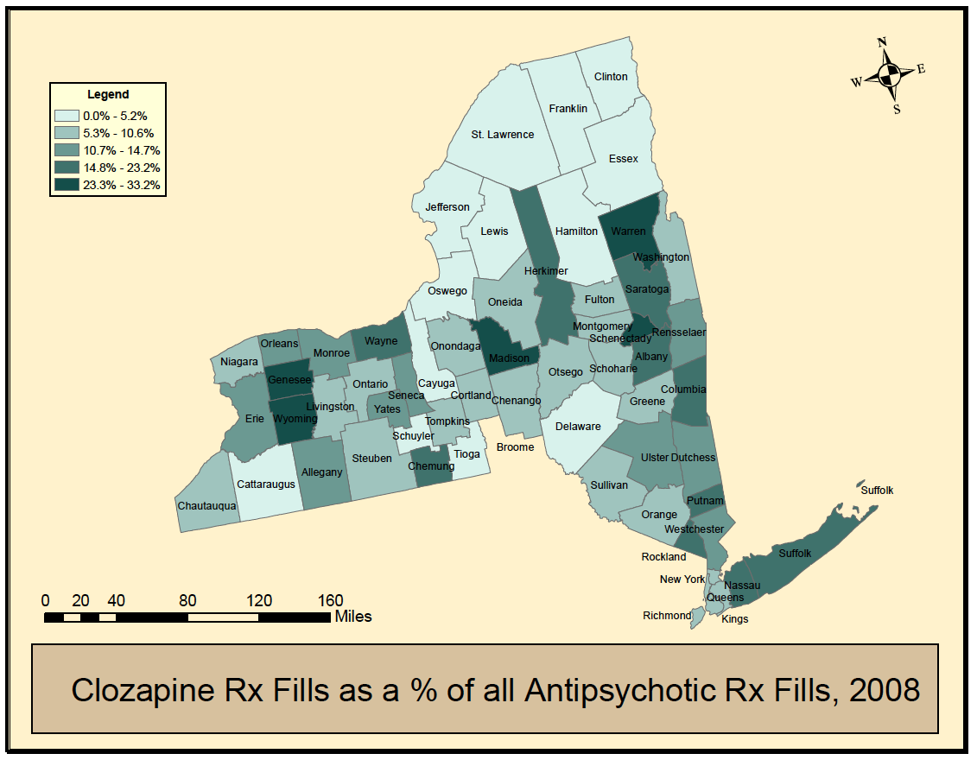

Slide 17
Barriers to Care
1. 50% of patients with anosognosia
2. Insane laws/no true insurance parity no access
3. 9-12 million people with psychosis spectrum disorders
4. Biggest psychiatric providers are jails
5. Chronically Homeless (Miami 85% suffer from persistent severe mental illness)
6. Poor Psychiatric Training in clozapine use and the low expectations for meaningful recovery in the Psychiatric Community. Poor understanding of risks and benefits. This must change. Psychiatrists must be “real doctors”. I have hope!

Slide 18
Clozapine Routine Medical Monitoring
1. Thorough physical with a body mass index and orthostatic blood pressures
2. Baseline brain MRI (If financially feasible)
3. Baseline echo and EKG and periodic follow up
4. Baseline and follow CBC with absolute neutrophil counts, chem panels including renal and liver function test, lipids, thyroid function, Glycohgb, and urine toxicology, immune/infect w/u, TDM is critical!
5. In those with tachycardia serum BNPs and Troponins
6. For those with dual diagnosis urine and serum tox screens and cotinine levels every visit

Slide 19
Clozapine Initiation
1. Slow titration
2. Get to therapeutic levels
3. See the patient every week
4. Shift to bedtime dosing

Slide 20
Predictable Side Effects and
How to Avoid Them
Weight Gain: Add diet and Metformin early consider SGLT2 inhibitors
High Triglycerides: Add statins and omega 3 and fibrates (fenofibrate)
Metabolic Syndrome and Diabetes: Add Metformin, SGLT2 inhibitors, high dose Zantac, plant based diet and exercise
Sinus Tachycardia: Add Beta Blockade Propranolol or in those with pulmonary disease Metoprolol
Seizure Prevention: Add Either Lamictal or Gabapentin or Topiramate or when violent Valproate
Drooling: Add .06% Ipatropium Nasal Spray and consider Glycopyrrolate and elevate the head of the bed

Slide 21
Predictable Side Effects and
How to Avoid Them
Constipation: Hydrate with water and coffee, cathartics(Dulcolax and Senna), stool softeners (Colace), laxatives (MOM, lactulose, Miralax), Linaclotide and Acarbose in those that can tolerate the flatulence. Remedy the problem which is a slow transit time.
Neutropenia draw blood in the afternoon and exercise before bloods. Consider lithium and granulcoyte CSF. Recognize BEN
Nocturia Use DDAVP start with 0.2 mg at bed and try psudofed.
Hypotension Florinef (hydrocortisone) start at 0.1 mg daily
Nausea and vomiting early use of ondansetron (Zofran)

Slide 22
Enhancing Clozapine
Cognitive enhancement: donepezil, memantine, modafanil, nuvigil, Amantadine, and consider fluvoxamine
Concomitant mood disorder and OCD add SSRI (ie Lexapro) and cognitive behavioral therapy, trial of Bupropion Very Carefully consider fluvoxamine (luvox)
Socialization social skills and fountain house. Befriend no barriers between the provider and the family and patient.
Educational, vocational support, cognitive and dialectical behavioral therapy and cognitive enhancement programs. We have just hired a social worker to help.
Family therapy and in the dual diagnosis addiction treatment
Exercise and Engagement is critical: Every Saturday morning I have my willing patients and families come to my house for a run and seasonally swim. The House is magic in fostering acceptance, engagement, and trust. It has taken the therapeutic relationship to another level. Normalization, socialization, and befriending in a non medical environment value cannot be overestimated. Even the texting helps.

Slide 23
The Diet - Drink
1. NEVER drink your calories
NO soda NO juice NO alcohol
Drink 3 liters of water or coffee daily
  2-4 cups coffee to suppress appetite
Milk: Almond milk or skim milk
4. Sweetners: Stevia or Splenda

Slide 24
The Diet - Eat
Eat 3 meals a day
Avoid all simple processed carbohydrates
  NO cookies, candy, chips, dips, cakes, ice cream, donuts
  Minimize bread, pasta (whole grain only)and rice (small portion brown rice only)
BREAKFAST
High fiber cereal or
Eggs, (Veg omelet) or
Oatmeal with raisins
Coffee or tea
Milks: Almond or Skim
Sweetners: Steevia or Splenda
LUNCH
Non tropical fruit
Blueberries, strawberries, blackberries, apples, plums or pears.
Greek yogurt 100-160cal
DINNER
Garden salad with only vegetables & a light low salt dressing spritzed on.
Vegetable like broccoli, brussel sprouts, string beans, spinach, or cauliflower.
Protein 6-8 ounce of fish, poultry, pork, tofu, setain. or a legume : lentils, chick peas etc.
Non tropical fruit
SNACK
Unsalted nuts or fruit
Blueberries, strawberries, blackberries, apples, plums or pears.

Slide 25
Clozapine P450 1A2
1. Cigarettes dramatically lower clozapine
A. Stopping dramatically raises levels
B. Hydrocarbons & coal tars stimulate metabolism
C. Nicotine has no affect
Caffeine - the more you drink the higher the levels Keep it steady
Be aware of drug interactions
i.e. quinolones increase levels

Slide 26
Luvox and Clozapine/TDM
Rationale Block CYp1A2 to increase ratio of clozapine/norclozapine for better efficacy and less side effects
39 patients data: Baseline cloz/norcloz 449/305 = 1.47
After fluvox: cloz/norcloz 682/239 = 2.6
Improvement in sedation, sleep time, weight, sialorrhea, positive and negative symptoms.
Able to take a subset of 11highly resistant patients. All are maintained with clozapine levels over 1000. 1 is working, 5 are full time students, 4 are in PROs programs, and the other attends a club house and is drug free for the first time in 20 years. I patient hospitalized after a medical error.
Only 1 seizure all patients maintained on Lamotrigine

Slide 27
Clozapine Clinic - The Dream
Generalize the model: maybe OMH will give us an opportunity to train OMH Psychiatrists on site
2. Psychiatric MD or NP adept in medicine
3. Full time psychiatric internist
4. Psychologist or psychiatric social worker for CBT
5. Social workers for case management and housing
6. Peer specialist
7. Social/work club house (Fountain House)/ Befriending, normalizing create a community.

Slide 28
Clozapine Clinic - The Dream
8. Exercise training and nutrition support
9. Family support and education/LEAP
10. Cognitive enhancement therapy with social skills and dialectical therapy and job training
11. Full supported housing
12. Substance abuse intervention for cigarettes, drugs and alcohol
13. Pet therapy (dogs matter)
14. Full Biopsychosocial model: Only goal Recovery

Slide 29
Work To Do
1. New laws Improve AOT/HIPAA/Rationale REMS
2. Improve and implement existing programs
3. Stop Professional stigma: Robust recovery is the norm
4. Early intervention and awareness Prodrome is high risk
5. L.E.A.P./Befriending/Family Involvement/Team Sport
6. Effective integrated treatment using clozapine as the foundation with appropriate wrap around services
Develop a long acting intramuscular clozapine
Demonstrate that it is all cost effective

Slide 30
The System
1. It is broken and fragmented
2. People are suffering
3. We can do better
4. We just need the will

Slide 32
Clozapine First The Study
1. Real world study in R.A.I.S.E. format
2. Use the same protocols clozapine vs usual first line antipsychotics
3. Track neuroimaging, hospitalizations, social history with GAF from investigators, self report and when available family report. Employment and educational history, metabolic parameters including weight, lipids and glycohemoglobins as a measure for glucose intolerance
5. 2 year initial reporting and follow longer longitudinally for a minimum of 5 years
6. Develop IM Clozapine

Slide 33
The Diet - Drink
1. NEVER drink your calories
NO soda NO juice NO alcohol
Drink 3 liters of water or coffee daily
  2-4 cups coffee to suppress appetite
Milk: Almond milk or skim milk
4. Sweetners: Stevia or Splenda

Slide 34
Clozapine Use Among Adult Medicaid Beneficiaries With Schizophrenia (N=629,809)
2015
Number of OP Visits for Schizophrenia
0-9 1.7%
10-29 2.3%
30-49 3.3%
50+ 3.7%
Mental Health Hospital Admissions
0 1.9%
1 2.7%
2 3.3%
3 3.8%
4+ 4.2%
Treatment resistance 5.5%
No treatment resistance 2.5%
Stroup, Gerhard, Huang, Crystal, Olfson
HR (95%CI)
1.0
1.32 (1.23-1.42)
1.77 (1.57-1.98)
2.06 (1.82-2.33)
1.0
1.19 (1.11-1.27)
1.36 (1.25-1.48)
1.51 (1.35-1.68)
1.62 (1.41-1.87)
1.92 (1.83-2.03)
1.0

Slide 35
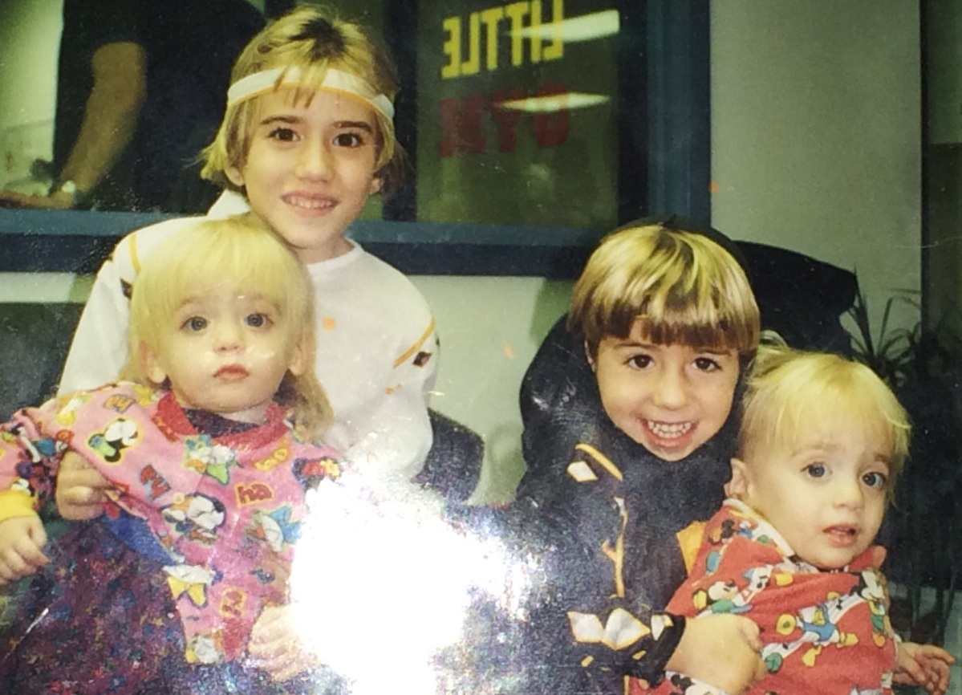
Daniel, 5 years old

Slide 36

Daniel at 20

Slide 37

Daniel at 22

Slide 38
Clozapine Benefits
1. Most effective
2. Reduces suicide
3. Reduces violent behavior
4. Reduces substance abuse
5. Allows patients to robustly participate and succeed in physical, social and cognitive rehabilitation
6. Best acceptance, lowest discontinuation,
and best survival

Slide 39
My Patients

