Slide 1
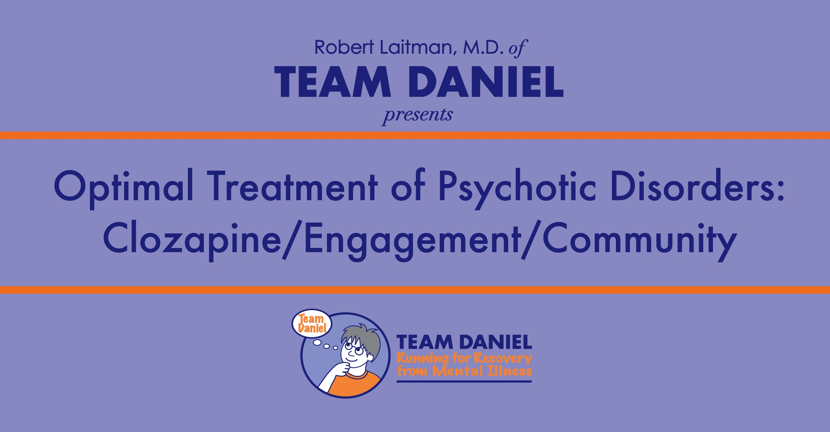

Slide 2
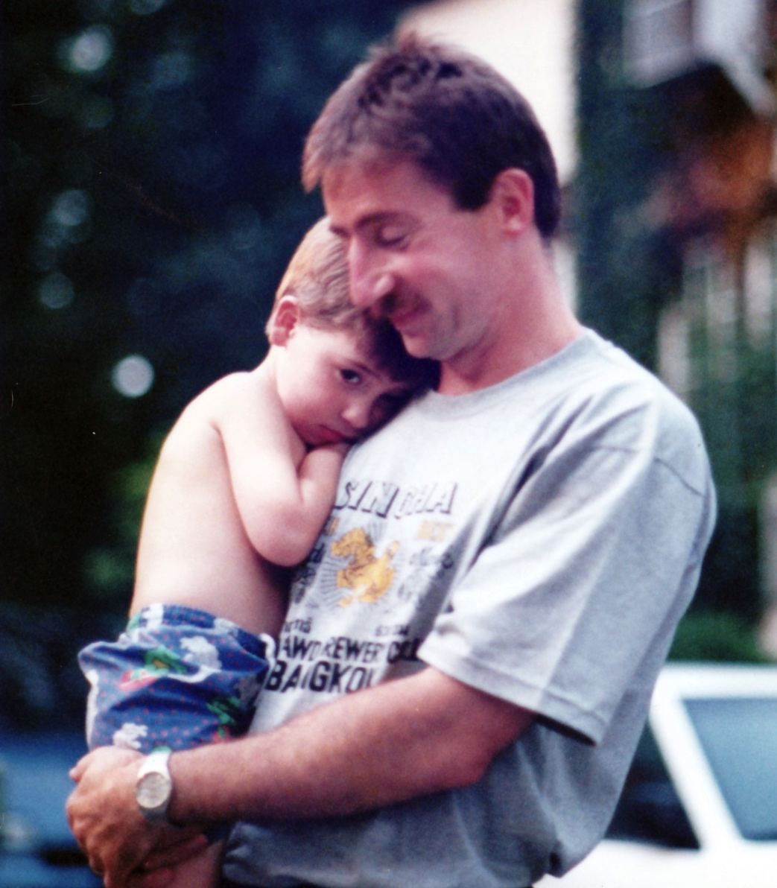
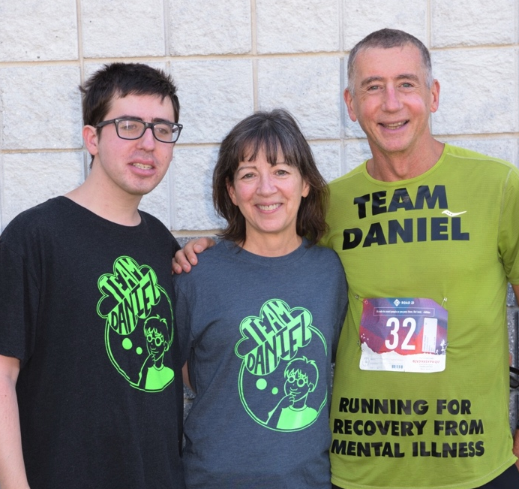
Our Daniel
1993
2019

Slide 3

Clozapine: An Historical Perspective
Clozapine has always challenged the mental health system
1953: FDA approved first Pharma “Blockbuster” Thorazine.
1958: Clozapine Synthesized by Schmutz.
1960: Clozapine was patented; patients and family loved it.
    Unfortunately, psychiatry avoided clozapine; most were preoccupied with the dopamine model for psychosis.
1989: Clozapine was FDA approved but held to an unprecedented standard.
    Demonstrated marked improvement in treatment refractory population when compared to standard of care.
    Sandoz bundled clozapine with the required blood monitoring; significantly increasing costs.
    Clozapine was heavily restricted and rationed.

Slide 4
Clozapine Risks
Agranulocytosis - Dangerously low neutrophils (white blood cells)
Seizures
Intractable weight gain in over 80% and diabetes
Unremitting sedation
Drooling
Intractable constipation
Myocarditis and heart failure
Rebound psychosis if withdrawn
Venous Thromboembolism (VTE)
Pulmonary Infection

Slide 5
Clozapine Benefits
FDA indicated for treatment-resistant schizophrenia, however:
It is the most effective medication in ALL settings.
Reduces suicide (FDA indicated).
Reduces violent behavior.
Reduces substance abuse
Allows patients to robustly participate and succeed in physical, social and cognitive rehabilitation.
Best acceptance, lowest discontinuation, and best survival.

Slide 6
Major Benefit: Lowers Risk of Death
First year of psychotic illness the risk of death 24 to 89 times the general population aged 16-30.
Suicide risk in psychotic spectrum illness:
    50% attempt, 10% completion (3-5 % in the first year).
    Clozapine reduces this risk by 80-90% compared to other antipsychotics.
    380 to 900 more survive for every10,000 treated with clozapine.
Agranulocytosis risks, for comparison:
    Only 0.3% to 0.8% occurrence, with overall mortality of 1 to 2.5 per 10,000.
    90- 95% of this risk occurs in the first 18 weeks.
    After 6 months the risk of death is no more than other antipsychotics.
    Context: Iceland does not monitor;1/10 of this 2/10,000.
Psychosis cuts life short by 20-25 years, mostly due to cigarette and drug use.
    Clozapine significantly reduces smoking and substance use disorders.

Slide 7
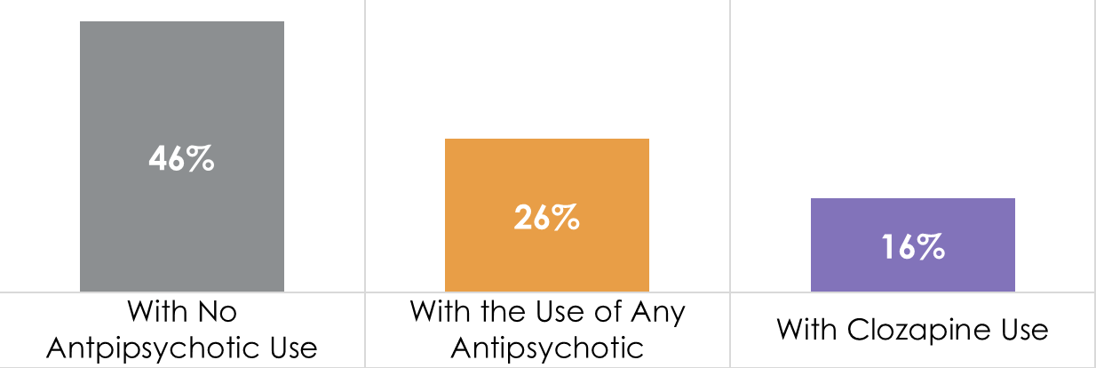
Live Longer on Clozapine
SCHIZOPHRENIA 20-YEAR MORTALITY RATE
A Finish 20-Year Study of >62,000 patients

Slide 8
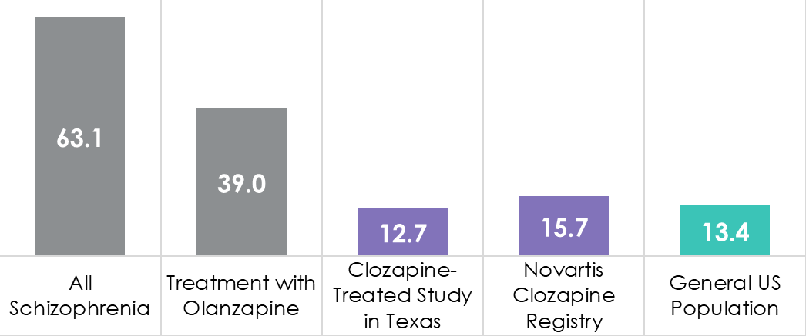
Reduced Suicide Rate
CLOZAPINE REDUCES SUICIDE RATE IN PATIENTS WITH SCHIZOPHRENIA
Annual Suicides Per 100,000

Slide 9
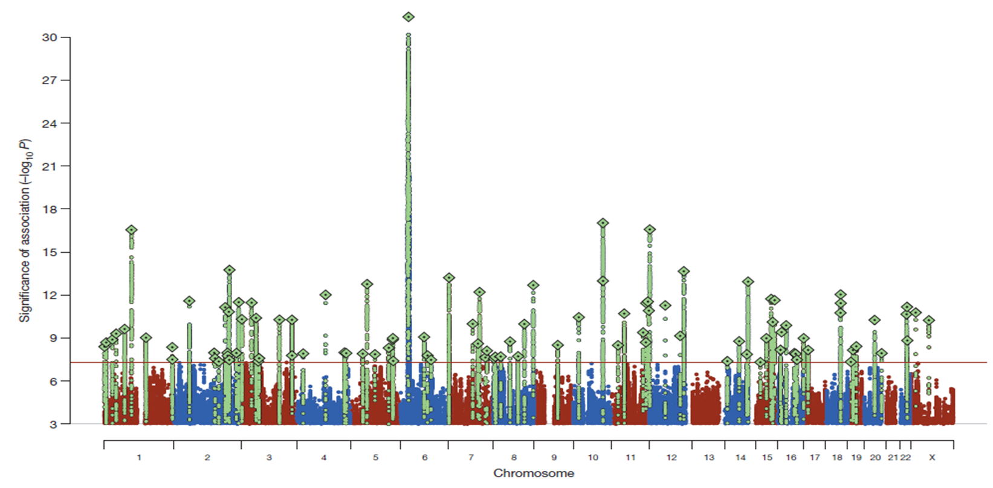
Pruning C4A & Schizophrenia
C4A Gene
SCHIZOPHRENIA RISK ASSOCIATED WITH 108 GENOMIC REGIONS
Schizophrenia Working Group of the Psychiatric Genomics Consortium. Nature 2014;511(7510):421–427.

Slide 10
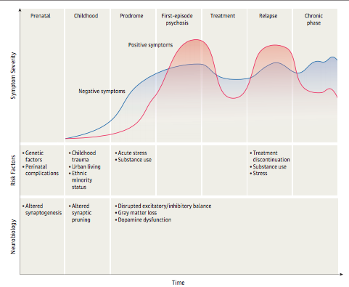
THE CLINICAL COURSE
OF SCHIZOPHRENIA
Schizophrenia—An Overview
Robert A. McCutcheon, MRCPsych; Tiago Reis Marques, PhD; Oliver D. Howes, PhD
Published online October 30, 2019.

Slide 11
Clinical Features of Psychosis
Positive symptoms
Delusions
Hallucinations
Disorganized speech
Catatonia
Negative symptoms
Affective flattening
Alogia
Avolition
Anhedonia
Social withdrawal
Social /occupational
dysfunction
Work
Interpersonal relationships
Self care
Mood symptoms
Depression
Hopelessness
Suicidality
Anxiety
Agitation
Hostility
Cognitive deficits
Attention
Memory
Executive functions
Processing speed
Comorbid substance abuse
Maguire 2002

Slide 12
The TEAM DANIEL Family
Our Cohort: A cohort of 95 patients that have received a clozapine-centered treatment approach for 1 year or longer, currently the subjects of an in-depth patient characterization study.
Family: Another 40+ (and counting) patients in earlier phases of their clozapine journey, with less than 1 year of treatment.
Extended Family: Over 100 more families following the clozapine-centered approach through consultation or co-following with Dr. Robert Laitman and Dr. Ann Mandel and unfortunately those that have left us due to a lack of engagement.

Slide 13
Who is TEAM DANIEL?
Patient Utilization Statistics
52% came to the practice to initiate clozapine.
  Previous providers could not- or would not- prescribe clozapine.
48% came to the practice already on clozapine.
  Still suffering from psychosis symptoms.
  Enduring intolerable side effects.
  Still not recovered to pre-illness baseline functioning and well-being.
  Previous providers unwilling to re-challenge after prior adverse effect.

Slide 14
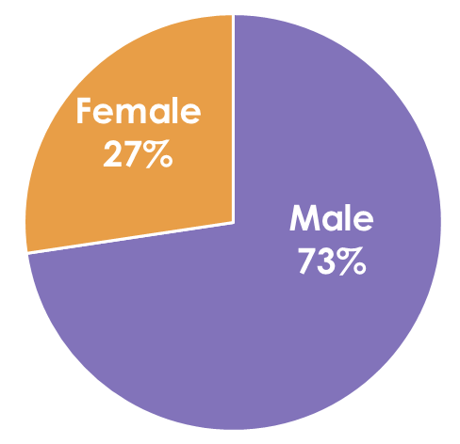
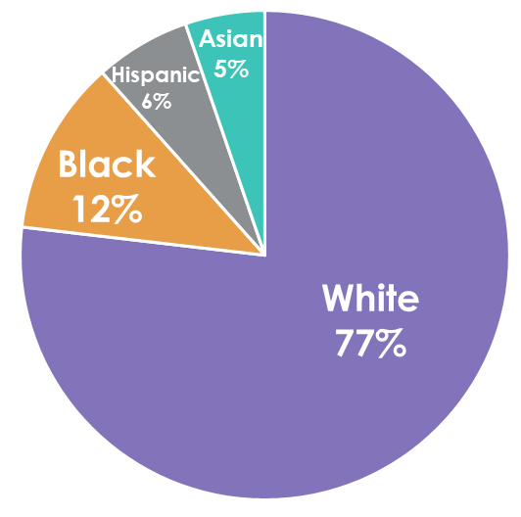
Our Demographics
TEAM DANIEL Profile Statistics
Average age: 34 years old
Youngest: 17
Oldest: 74
Longest patient on clozapine:
30 years (and counting)
All genetic profiles, backgrounds and ethnicities respond better to clozapine than any other antipsychotic.
Asians, females and non-smokers may respond to lower dosages, on average.

Slide 15
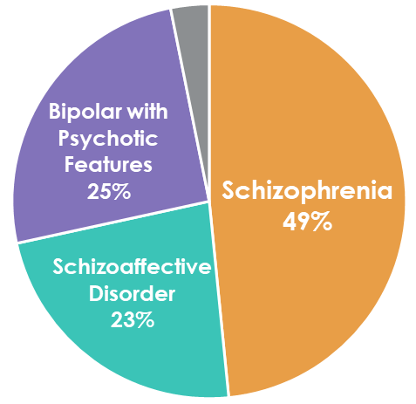
Our Demographics
Compelling Statistics
4 of the 95 Team Daniel cohort patients are no longer on clozapine due to their psychiatric condition resolving.
Two of the 4 received clozapine first!
56% characterized with anosognosia (poor insight).
8 patients on Assisted Outpatient Treatment (AOT).
Other 3%
Clozapine can be used for drug-induced psychosis, borderline personality disorder, severe insomnia, depressive disorder with psychosis, and other conditions.

Slide 16
Not Every Success
Not Every Patient is Still With Us…
18 Refused or never started treatment; unable to obtain an AOT.
9 Discontinued treatment or transitioned to other medications.
  Other antipsychotic, mood stabilizer or cognition medications.
  1 due to clozapine adverse effect: cardiomyopathy in an elderly transplant patient.
2 Deaths
  1 elderly patient
  1 suicide
12 Lost to follow up or transferred to another practice.
2 Dismissed from practice.

Slide 17
How is TEAM DANIEL Different?
We use Clozapine First… NOT as a last resort!
We believe patients have a Right to Be Well and encourage the use of LEAP and if needed court-ordered Assisted Outpatient Treatment (AOT).
We do not tolerate side effects, including weight gain, and we aggressively use adjunctive medications, ultra-slow titrations, diet and exercise to treat and prevent them.
Our goal is Meaningful Recovery and returning patients to their pre-illness baseline level of functioning and well-being.
We promote a sense of community and engage and communicate with the patient’s Family. After learned helplessness and hopelessness we restore optimism.

Slide 18
Our Goals: Restore
We CAN restore optimal health – body and mind.
Patient has a sense of purpose and self, enabling them to form relationships and be a productive member of their community and society.
Vital individuals with optimal physical functioning.
Pain-free both physically and emotionally enjoying long and fulfilling lives.
The Goal: Meaningful Recovery.
We CAN restore hope – patient and family

Slide 19
Clozapine First
This is what we believe. Why? Change the disease!
  Early treatment leads to best outcomes: Including survival.
  Shorten the duration of untreated psychosis (DUP) by early treatment with clozapine; the earlier it is used the better.
  Better compliance and faster and more robust recovery.
  Decrease early suicide (24X increased mortality the first year).
  Decrease early aggression (12% serious violence.)
  Superior in adherence, quality of life, and patient satisfaction.
  Reduces drug and cigarette abuse.
  Patients respond better to psychosocial support.
  Patients achieve robust Meaningful Recovery.

Slide 20
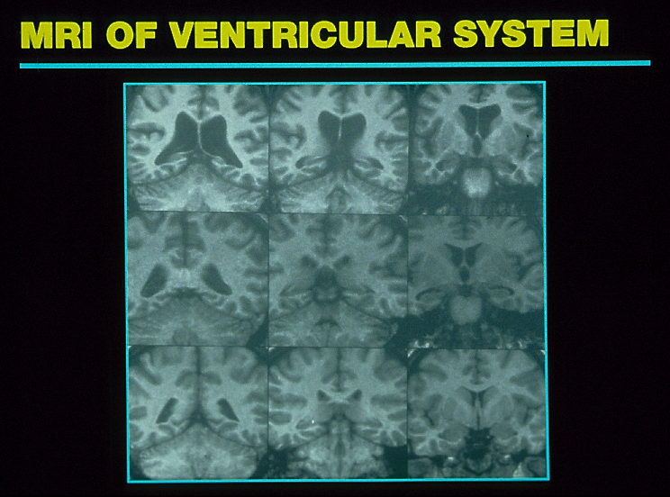
PROGRESSIVE MRI CHANGES OVER THREE RELAPSES IN A MALE WITH SCHIZOPHRENIA
After 8 Relapses
Worsening Progression
After 3 Relapses
First psychotic episode
Nasrallah, HA. personal files

Slide 21
Our Meaningful Recovery
With TEAM DANIEL it means achieving any of the following:
  Employed for 20 hours per week or more.
  Attending school full-time, or part-time with other activities.
  Responsibly maintaining a homemaker and/or parenting role.
  Successfully participating in a vocational rehabilitation program.
  Successfully engaged in consistent volunteer activity for 20 hours per week or more.

Slide 22
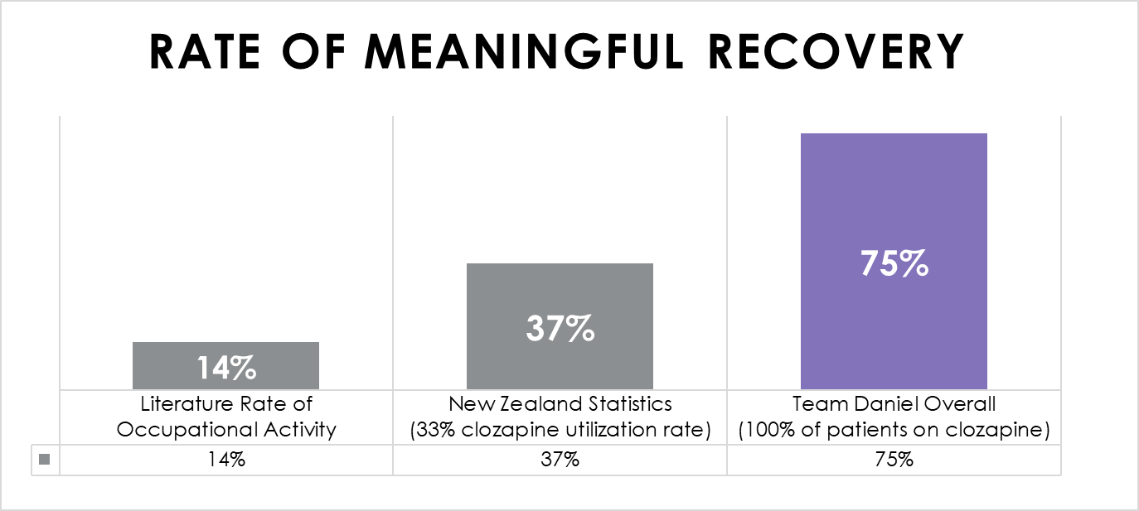
RATE OF MEANINGFUL RECOVERY
N = 95 Patients on an Optimized Clozapine Regimen

Slide 23
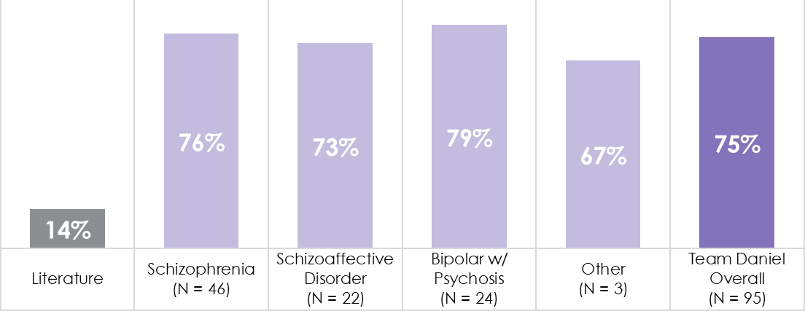
RATE OF MEANINGFUL RECOVERY BY DIAGNOSIS

Slide 24
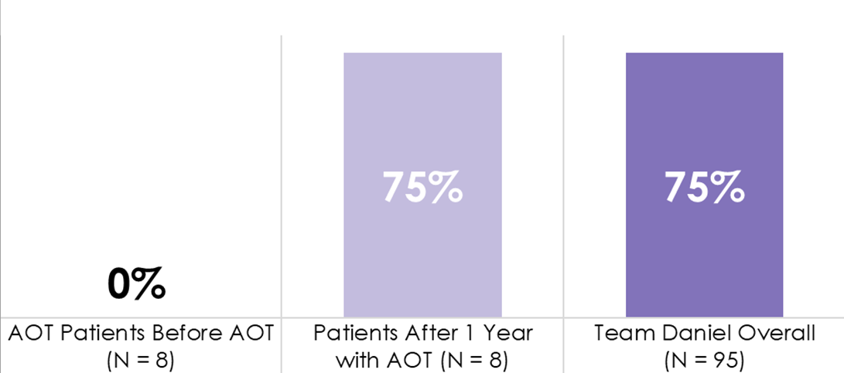
AOT Saves Lives and Livelihoods
100% Significant Improvement in Quality of Life
No hospitalizations!
MEANINGFUL RECOVERY WITH ASSISTED OUTPATIENT TREATMENT (AOT)

Slide 25
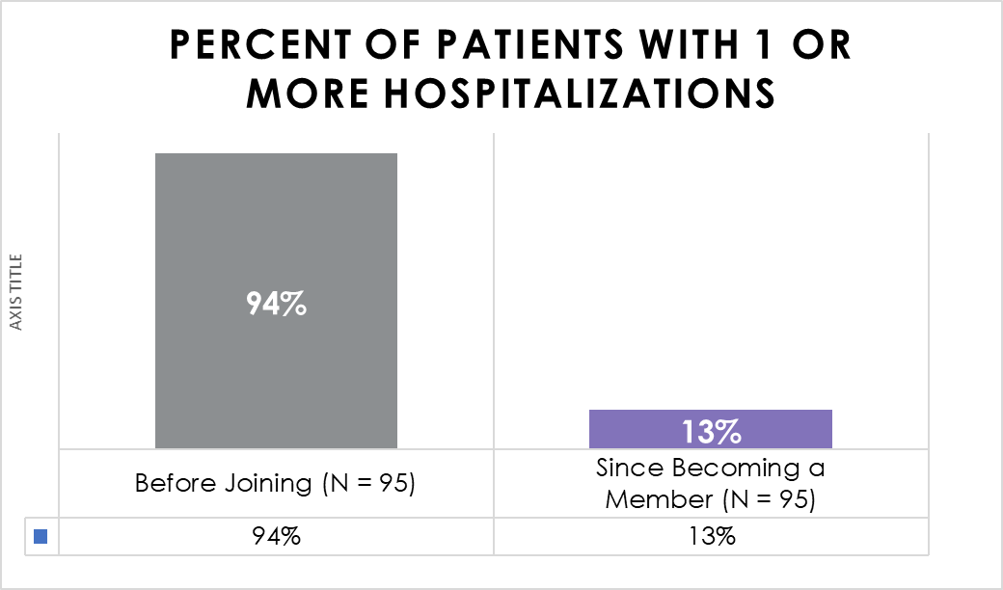
87% Never See Hospital Again
12 Hospitalizations:
5 for Mental health
1 for Substance Use
4 for Adverse effect:
  2 Seizures
  1 Pneumonia
  1 Lithium toxicity
2 for Medical reasons
PATIENTS WITH ONE OR MORE HOSPITALIZATIONS

Slide 26
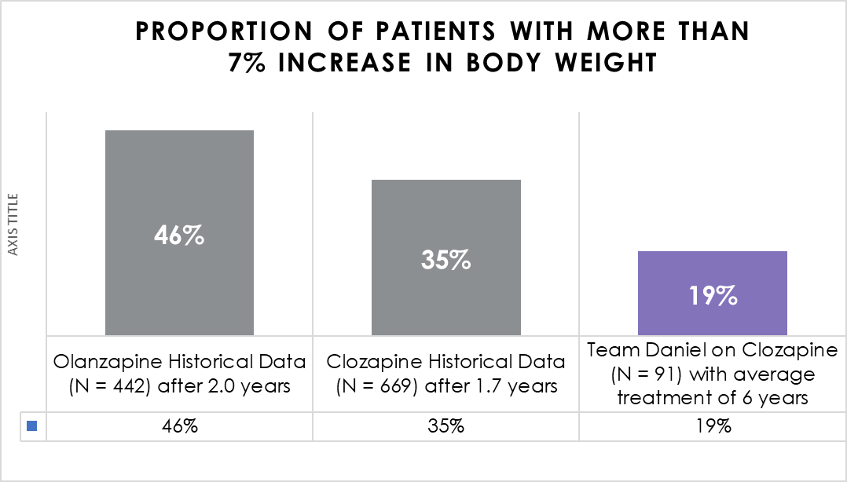
PROPORTION OF PATIENTS WITH MORE THAN 7% INCREASE IN BODY WEIGHT

Slide 27
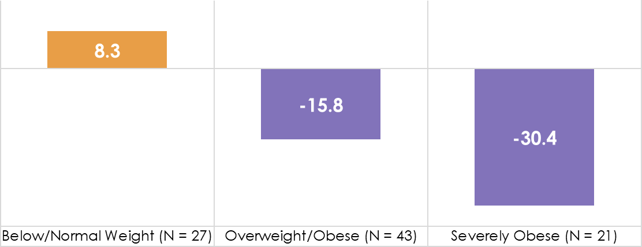
TEAM DANIEL ON CLOZAPINE AVERAGE WEIGHT CHANGE (LB)

Slide 28
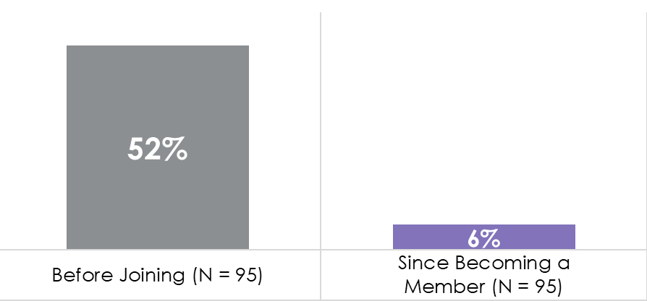
Recovery Rate Unprecedented
88% Recovery from Substance Use
86% Recovery from Cannabis Use
RATE OF SUBSTANCE USE DISORDER
Most Common: 90% Of Use Was Cannabis

Slide 29
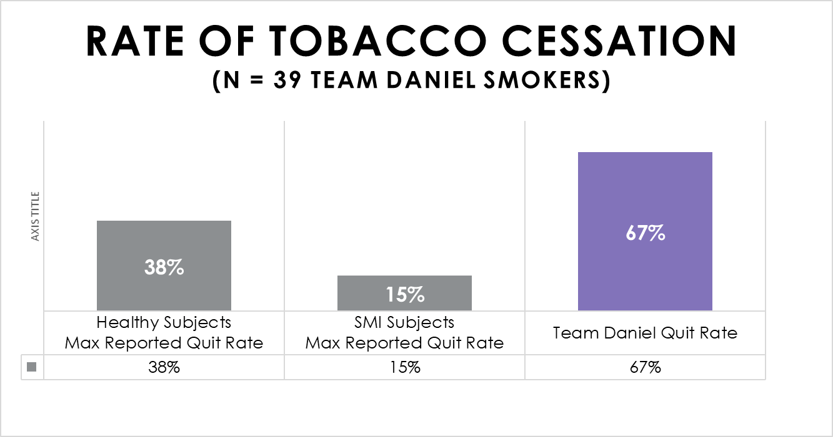
Cessation Rate Beats The Odds
26 of 39 Smokers Quit
Most used
combination therapy:
82% Chantix
49% NRT
64% Bupropion
RATE OF TOBACCO CESSATION
(N=39 Team Daniel Smokers)

Slide 30
TEAM DANIEL NOTABLE ADVERSE EVENTS (N=95)*

Slide 31
OTHER OBSTACLES AND CHALLENGES (N=95)

Slide 32
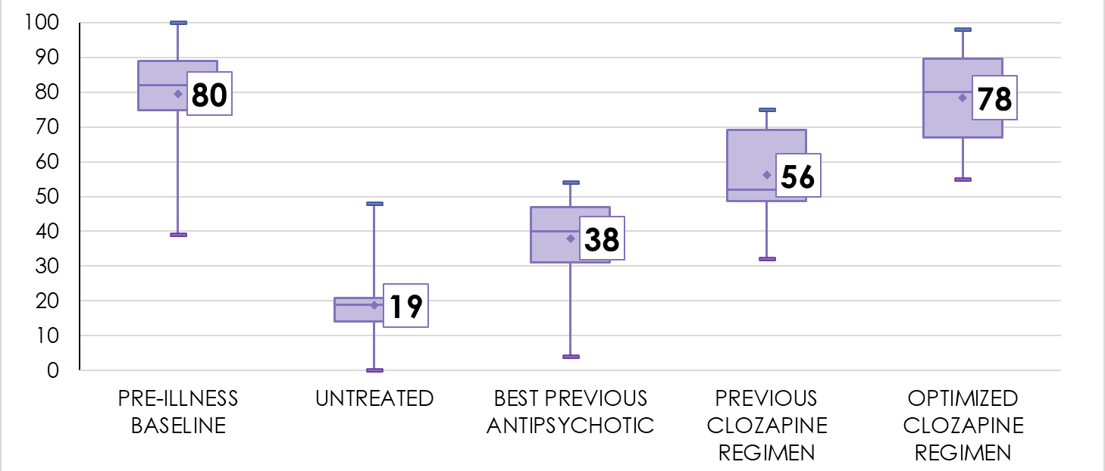
Our Patients Return to Baseline
TEAM DANIEL
Returns to Baseline Functioning &
Well-being
GLOBAL ASSESMENT OF FUNCTIONING SCORES
Preliminary Data (N=14)

