Slide 1
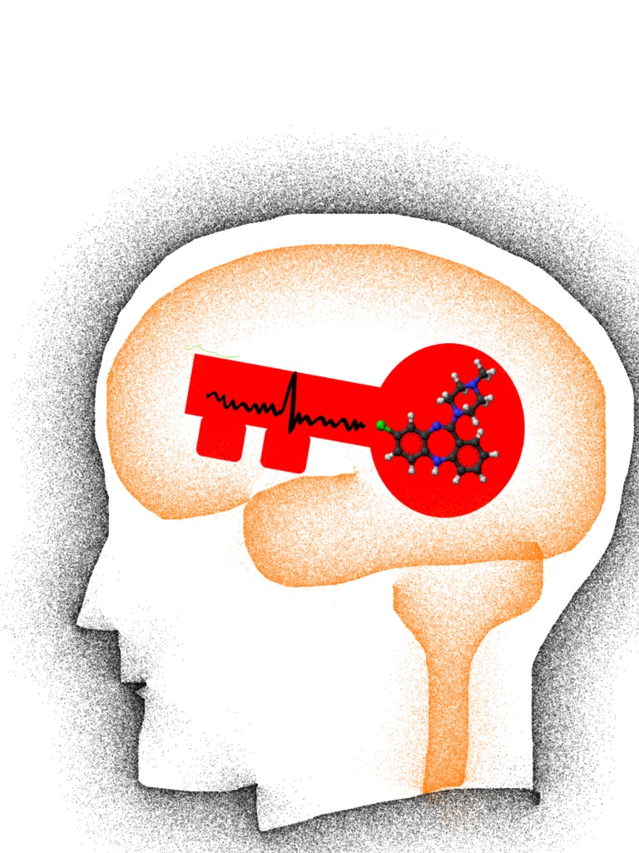
Antipsychotic Response to Clozapine in B-SNIP Biotype-1 (The CLOZAPINE study )
Matcheri Keshavan MD
Harvard Medical School, Massachusetts Mental Health Center and BIDMC
Clementz
Keshavan
Tamminga
Gershon
Pearlson
Notes:
Current psychiatric classifications do not identify etiopathologically-based entities. A recent approach to address this gap in knowledge is to develop neuroscience based, behaviorally-relevant neural systems whose pathologies (albeit yet incompletely defined) cut across DSM disorders (the research domain criteria, or RDoC); these may better map to neural basis and outcome in psychiatric illnesses (Insel and Cuthbert, 2010). These rDoc domains, currently include cognition, positive and negative valence, arousal and social cognition. However, applying this approach to complex psychopathological syndromes such as psychosis is challenging because of the co-occurrence of impairments multiple behavioral dimensions that do not easily translate to the proposed R-DoC constructs.
The Bipolar Schizophrenia Network for Intermediate Phenotypes (B-SNIP) consortium deconstructs pathophysiological processes in the psychosis dimension across DSM diagnoses. In this session, we examine B-SNIP data using an R-DoC framework. The conceptual basis of this approach will be outlined first (Matcheri Keshavan). Cognitive impairments will be examined for their structural (MRI, DTI), functional (fMRI), electrophysiological (ERP, resting fMRI) and genetic correlates (John Sweeney). Affective symptoms will be examined across these domains by Godfrey Pearlson. Psychosis will be similarly examined across these structural, functional, physiologic and molecular biomarkers by Carol Tamminga. Investigation of psychopathological dimensions across the RDoC translational units of analyses may yield pathophysiologically meaningful entities informing valid etiology, treatment response and illness trajectories than symptom-based phenotypes alone. Mining deep phenotyping data in psychoses using R-DoC like approaches may model for and broadly relate to psychopathology in general, and will be discussed by Peter Buckley.

Slide 2
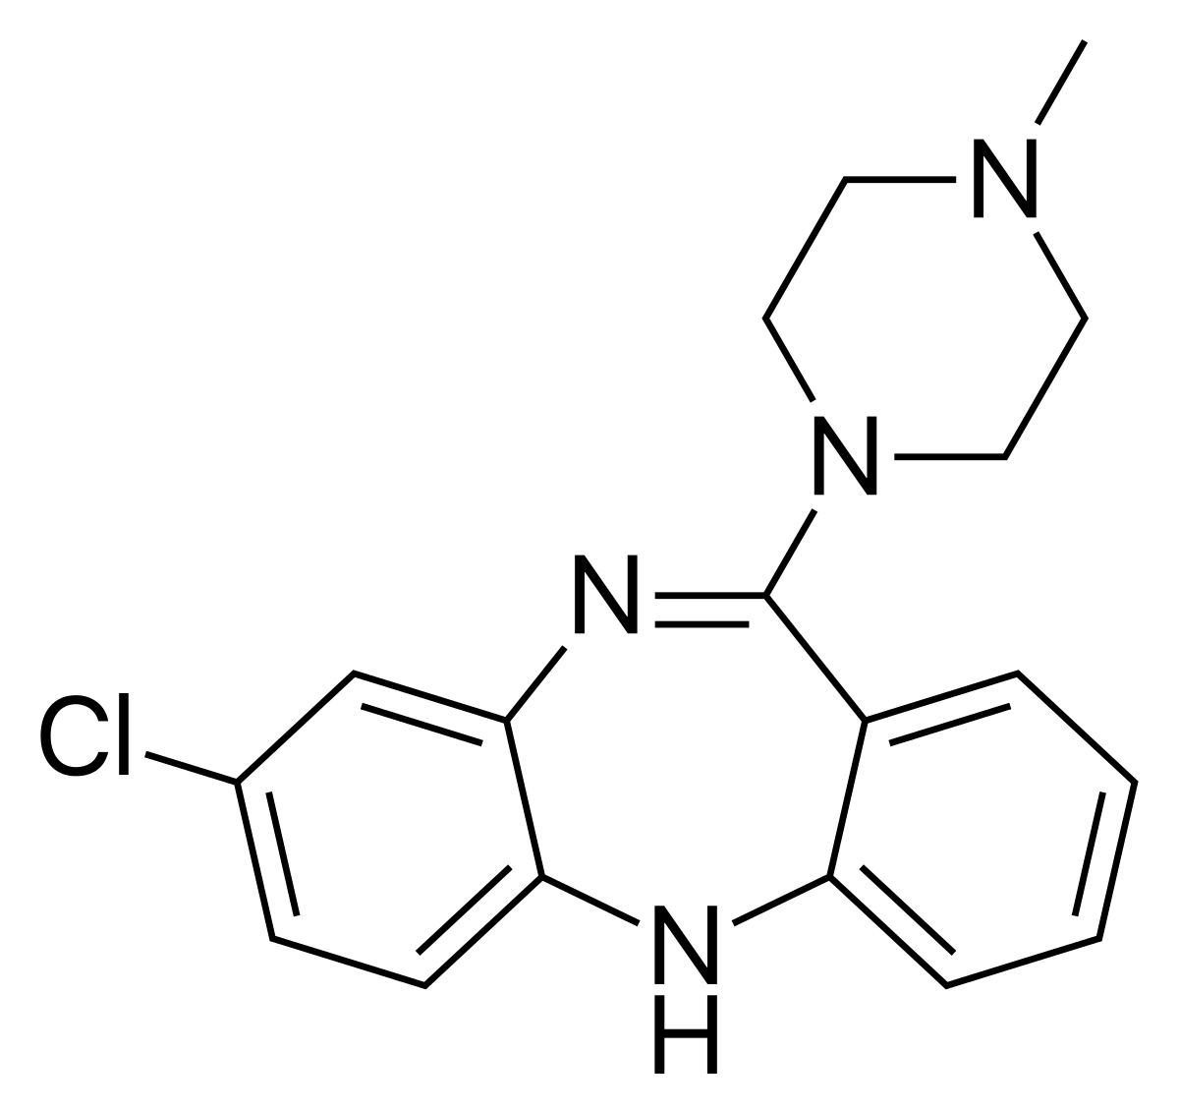
CLOZAPINE MECHANISM OF ACTION IS UNKNOWN
Weight gain, sedation
H1
Antipsychotic effect
D3, D4
Clozapine
D2
? Antipsychotic effect
5HT2
a1
Freedom from
Extrapyramidal
Side effects
Postural hypotension
M1
There are no predictive biomarkers
Available at this time for clozapine response
Biomarker prediction critically needed because
of the High benefit, but high risk profile of clozapine
Antipsychotic effect?
? Seizure effect
Drooling
Constipation, blurred vision

Slide 3
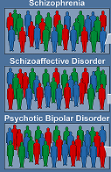
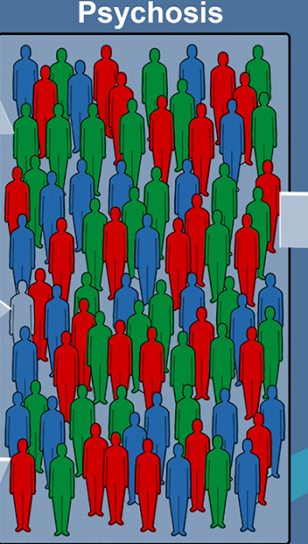
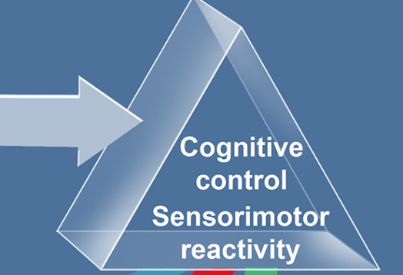
DSM diagnoses are based on symptom groupings, not on biology
Toward a neuroscience based classification of psychotic disorders
Using EEG and cognitive biomarkers (BSNIP, n=2000) Clementz et al 2016
Most cognitively impaired, strong
family history, may respond to clozapine?
neurostimulation
May be related to inflammation
? Respond to anticonvulsants
? Anti-inflammatory ? Inhibitory neuromodulation
Relatively normal cognition
May be more likely cannabis/
trauma related

Slide 4
Biotypes of psychoses: Toward hypothesis-driven
interventions
Healthy Biotype 1 Biotype 2 Biotype 3
Healthy Decreased
neural response
Increased
Background
neural activity
Relatively
normal
? Altered
endocannabinoids
? Clozapine
Cognitive
remediation
HF rTMS
Anodal TDCS
iTBS
? Valproate
LF rTMS
Cathodal TDCS
cTBS
Potential
interventions
? CBD

Slide 5
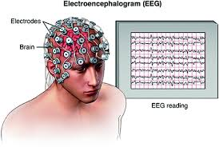
Selective Antipsychotic Response to
Clozapine in B-SNIP Biotype-1 (the
Clozapine study, NIMH)
M S Keshavan MD (PI), Roscoe
Brady MD PhD and Cris Coconcea
Investigators at Boston site
Clozapine
Stable symptomatic
patients
Risperidone
Safety monitoring
Clinical outcome
measures
EEG Biomarkers

Slide 6
Hypotheses:
Clozapine, not risperidone will increase intrinsic EEG activity
Increased IEA correlates with therapeutic response
Biotype 1 patients and not Biotype 2 patients will respond
better to clozapine

Slide 7
Inclusion Criteria
1.Males and females, all races and ethnicities
2. 18-50y/o
3. Meet DSM-IV criteria for schizophrenia, schizoaffective disorder, or bipolar I disorder with psychotic features
Exclusion Criteria
1. Premorbid intellectual ability<70 (WRAT-4)
2. Neurological or medical disorder that may affect brain function (e.g., seizure disorder, TBI with a loss of consciousness ≥30 min, history of stroke, AIDS, etc.)
3.Comorbid substance abuse in prior 1 month or substance dependence in prior 3 months
4.Concomitant medications known to affect EEG properties (i.e., lithium, anticonvulsants, benzodiazepines) if they cannot be safely discontinued
5. Concomitant strong CYP 1A2 inhibitors (e.g., ciprofloxacin) or strong CYP 3A4 inducers (e.g., phenytoin, carbamazepine, phenobarbital, rifampin)
6. Vulnerable populations (e.g. pregnant, nursing, incarcerated)
7. History of neuroleptic malignant syndrome.
4. PANSS total score of ≥54 and at least one item scored ≥4 on PANSS Positive Subscale 5. Normal baseline values for: -Absolute Neutrophil Count (ANC): ≥1500/mm3
6. Able to read, speak, and understand English
7. Able and willing to provide written informed consent, and willing to commit to the study protocol

Slide 8
Recruitment, Screening and Biotype Identification
(n=524: 50% (n=262) from B-SNIP Library and New Cases, each)
Screen-out Biotype 3 cases
Biotype new Biotype 1 and Biotype 2 cases
Aim1: Preparation for Clinical Trial
Week 1 – Week 3
Simplify medication regimens to a single APD (and an Antidepressant, as indicated)
(n=320)
Aim2: Cross-Titration of Biotype 1 and Biotype 2 to Clozapine or Risperidone
Week 4 – Week 9
• Double-blinded cross-titration from previous APD to Clozapine (up to 500mg/day) or Risperidone (up to 6 mg/day)
Aim3: Contrasting Clozapine and Risperidone Outcomes
Week 10 – Week 18
‘Stable treatment’ with Clozapine or Risperidone
(n=160, 40 Completers/group)
Safety Monitoring:
Physician Visits, Side Effect Scales, CBC & diff [Weeks 4 – 18, weekly]
Medication Plasma Levels [Weeks 6 – 18, bi-weekly]
Comprehensive blood tests (CMP, Lipid Panel), EKG [Weeks 4 – 18, every 4 weeks]
Clinical Outcome Assessments:
PANSS, CGI, MADRS, YMRS [Weeks 4 – 18, bi-weekly]
Biomarker Outcome Assessments:
EEG (Intrinsic Activity, ERP, Steady State); Cognition (BAC, Antisaccades)
[Weeks 4, 10, 12, 14, 16, 18]

